Slide 1

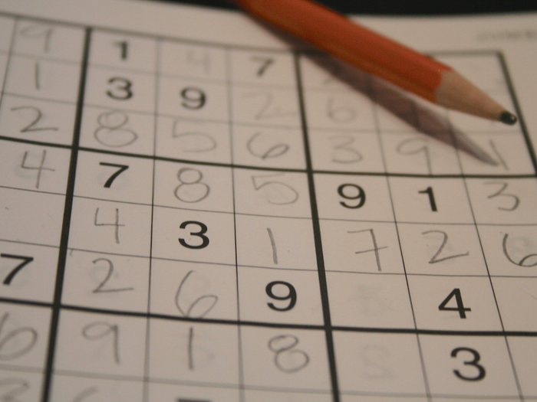
SUDOKU Solver
TEAM MEMBERS
1]2010030015-Anil kumar
2]2010030015-Sai Rishal
3]2010030288-Dileep sai lavu
3]2010030343-Simon Sumanth

Slide 2
Abstract
Sudoku is the Japanese abbreviation of a phrase meaning the digits must remain single , also known as Number Place, where Su means number, doku which translates as single or bachelor. Sudoku is not a mathematical or arithmetical puzzle. It works just as well if the numbers are substituted with letters or some other symbols, but numbers work best. The aim of the puzzle is to enter a numerical digi from 1 through 9 in each cell of a 9×9 grid made up of 3×3 sub squares or sub grids, starting with various digits given in some cells; each row , column, and sub squares region must contain each of the numbers 1 to9 exactly once.
Throughout this document we refer to the whole puzzle as the grid/game board, a 3x3 sub grid as a block and the individual grids that contains the number as a cell.

Slide 3
PROBLEM STAEMENT
Function
Function for highlighting selected cell
Function
Function to draw lines for making sudoku grid
Function
Function to fill value in the cell
Function
Function for raising error when wrong value is entered
Function
Function to check if the entered value is valid
Function
Function to solve sudoku game
Function
Function to show result

Slide 4
ABBREVATIONS AND DEFINations
Sudoku: is a logic-based, combinatorial number placement puzzle [4]. The word “Sudoku” is short for Su-ji wa dokushin ni kagiru (in Japanese), which means “the numbers must be single”, see Fig.1.
Box (Region, Block): a region is a 3x3 box like the one shown in figure 1. There are 9 regions in a traditional Sudoku puzzle.
Cell (Square): is used to define the minimum unit of the Sudoku board. Candidates: the number of possible values that can be placed into an empty square. Clues: the given numbers in the grid at the beginning.

Slide 5
PROPOSED ALGORITHM DESIGN TECHNIQUES
BACKTRACKING METHOD
BRUTE FORCE ALGORITHM
EXACT COVER
RESIDUALS TECHNIQUE

Slide 6
BACKTRACKING
The unique missing method and the naked single method are able to solve all puzzles with easy and medium level of difficulties. In order to solve puzzles with even more difficult levels such as hard and evil the backtracking method has been used to complete the algorithm. A human player solves the puzzle by using simple techniques. If the puzzle is not solvable by using the techniques the player then tries to fill the rest of the empty squares by guessing.
The backtracking method, which is similar to the human strategy (guessing), is used as a help method to the pencil-and-paper algorithm. In other words, if the puzzle cannot be filled when using the unique missing method and the naked single method, the backtracking method will take the puzzle and fill the rest of empty squares. Generally, the backtracking method find empty square and assign the lowest valid number in the square once the content of other squares in the same row, column and box are considered. However, if none of the numbers from 1 to 9 are valid in a certain square, the algorithm backtracks to the previous square, which was filled recently.

Slide 7
EXACT COVER
Let S = {A, B, C, D, E, F} be a collection of subsets of a set X = {1, 2, 3, 4, 5, 6, 7} such that:
A = {1, 4, 7};
B = {1, 4};
C = {4, 5, 7};
D = {3, 5, 6};
E = {2, 3, 6, 7}; and
F = {2, 7}.
Then the subcollection S* = {B, D, F} is an exact cover, since each element in X is contained in exactly one of the subsets:

Slide 8
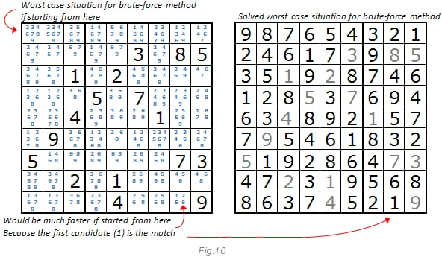
Brute Force Solver
The second algorithm that is examined in this work is Brute force algorithm. Usually, the brute force algorithm can be applied to any possible algorithm. For example when finding password, the algorithm generates any possible password until the right one is found. In this case the algorithm goes through every empty square and places a valid digit in that square. If no valid number is found the algorithm comes back to the previous square and change the value in that square. The process is repeated until the board is filled with numbers from 1 to 9.
The advantage of the brute force algorithm is that the algorithm can guarantee a solution to any puzzles since it generates all possible answers until the right answer is found if the puzzles are valid [9]. Additionally, the running time can be unrelated to level of difficulty, because the algorithm searches for every possible solution.

Slide 9
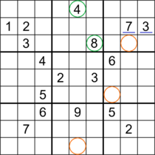
RESIDUAL TECHNIQUE
Residuals are the leftover variation in the data after accounting for the model fit: Each observation will have a residual. If an observation is above the regression line, then its residual, the vertical distance from the observation to the line, is positive.

Slide 10

GITHUB SETUP
https://github.com/data-and-analysis-of-algorithms

Slide 11

THANK YOU

